Slide 1
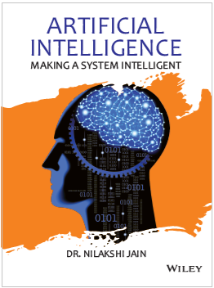
Chapter Sixteen
Cognitive Computing

Slide 2
Learning objectives.
16.1 Introduction
16.2 What is cognitive computing?
16.3 Definition
16.4 How cognitive computing work?
16.5 Cognitive computing Vs Artificial intelligence
16.6 Foundation of cognitive computing
16.8 List of design principles of cognitive system
16.9 Natural language in support of cognitive system
After this chapter , students will be able to :
Understand the concept of cognitive computing
Comprehend the role of natural processing in cognitive system

Slide 3
Comparison of Silicon Computers and Carbon Computers
16.1 Introduction
16.2 What is cognitive computing?
16.3 Definition
16.4 How cognitive computing work?
16.5 Cognitive computing Vs Artificial intelligence
16.6 Foundation of cognitive computing
16.8 List of design principles of cognitive system
16.9 Natural language in support of cognitive system
Digital computers are
Made from silicon
Accurate (essentially no errors)
Fast (nanoseconds)
Execute long chains of serial logical operations (billions)
Irritating to humans

Slide 4
Comparison of Silicon Computers and Carbon Computers
16.1 Introduction
16.2 What is cognitive computing?
16.3 Definition
16.4 How cognitive computing work?
16.5 Cognitive computing Vs Artificial intelligence
16.6 Foundation of cognitive computing
16.8 List of design principles of cognitive system
16.9 Natural language in support of cognitive system
Brains are
Made from carbon compounds
Inaccurate (low precision, noisy)
Slow (milliseconds, 10⁶ times slower)
Execute short chains of parallel alogical associative operations (perhaps 10 operations)
Understandable to humans

Slide 5
Performance of Silicon Computers and Carbon Computer
16.1 Introduction
16.2 What is cognitive computing?
16.3 Definition
16.4 How cognitive computing work?
16.5 Cognitive computing Vs Artificial intelligence
16.6 Foundation of cognitive computing
16.8 List of design principles of cognitive system
16.9 Natural language in support of cognitive system
Huge disadvantage for carbon: more than 10¹² in the product of speed and power.
But we do better and faster than them in many tasks:
speech recognition,
object recognition,
face recognition,
motor control
most complex memory functions,
information integration.
Implication: Cognitive “software” uses only a few but very powerful elementary operations.

Slide 6
Why Build a Brain-Like Computer?
16.1 Introduction
16.2 What is cognitive computing?
16.3 Definition
16.4 How cognitive computing work?
16.5 Cognitive computing Vs Artificial intelligence
16.6 Foundation of cognitive computing
16.8 List of design principles of cognitive system
16.9 Natural language in support of cognitive system
1. Engineering.
Computers are all special purpose devices.
Many of the important practical computer applications of the next few decades will be cognitive:
• Language understanding.
• Internet search.
• Cognitive data mining.
• Decent human-computer interfaces.
We feel it will be necessary to have a brain-like architecture to run these applications efficiently.

Slide 7
16.1 Introduction
16.2 What is cognitive computing?
16.3 Definition
16.4 How cognitive computing work?
16.5 Cognitive computing Vs Artificial intelligence
16.6 Foundation of cognitive computing
16.8 List of design principles of cognitive system
16.9 Natural language in support of cognitive system
2. Kinship Recognition, Human Factors:
To be recognized as intelligent by humans, a machine has to have a somewhat human-like intelligence.
There may be many kinds of intelligence, but we can only understand and communicate with one of them!
Successful human-computer interactions will require a brain-like computer doing cognitive computation.
“If oxen and horses had hands and could create works of art, horses would draw pictures of gods like horses and oxen, gods like oxen …”
Xenophanes (C. 530 B.C.E.)

Slide 8
16.1 Introduction
16.2 What is cognitive computing?
16.3 Definition
16.4 How cognitive computing work?
16.5 Cognitive computing Vs Artificial intelligence
16.6 Foundation of cognitive computing
16.8 List of design principles of cognitive system
16.9 Natural language in support of cognitive system
3. Personal:
It would be the ultimate cool gadget.
A technological vision:
In 2050 the personal computer you buy in Wal-Mart will have two CPU’s with very different architecture:
First, a traditional von Neumann machine that runs spreadsheets, does word processing, keeps your calendar straight, etc. What they do now.
Second, a brain-like chip
• To handle the interface with the von Neumann machine,
• Give you the data that you need from the Web or your files (but didn’t think to ask for).
• Be your silicon friend, guide, and confidant.

Slide 9
History: Technical Issues
16.1 Introduction
16.2 What is cognitive computing?
16.3 Definition
16.4 How cognitive computing work?
16.5 Cognitive computing Vs Artificial intelligence
16.6 Foundation of cognitive computing
16.8 List of design principles of cognitive system
16.9 Natural language in support of cognitive system
Many have proposed the construction of brain-like computers for cognitive computation.
These attempts usually start with
• massively parallel arrays of neural computing elements
• elements based to some degree on biological neurons,
• the layered 2-D anatomy of mammalian cerebral cortex.
Such attempts have failed commercially.
The early connection machines from Thinking Machines,Inc.,(W.D. Hillis, The Connection Machine, 1987) was the most nearly successful commercially. .
Consider the extremes of computational brain models:

Slide 10
First Extreme: Biological Realism
16.1 Introduction
16.2 What is cognitive computing?
16.3 Definition
16.4 How cognitive computing work?
16.5 Cognitive computing Vs Artificial intelligence
16.6 Foundation of cognitive computing
16.8 List of design principles of cognitive system
16.9 Natural language in support of cognitive system
The human brain is composed of on the order of 10¹⁰ neurons, connected together with at least 10¹⁴ neural connections. (Probably underestimates.)
Biological neurons and their connections are extremely complex electrochemical structures. The more realistic the neuron approximation the smaller the network that can be modeled.
There is very good evidence that for cerebral cortex a bigger brain is a better brain.
Projects that model neurons are of scientific interest.
They are not large enough to model or simulate interesting cognition.

Slide 11
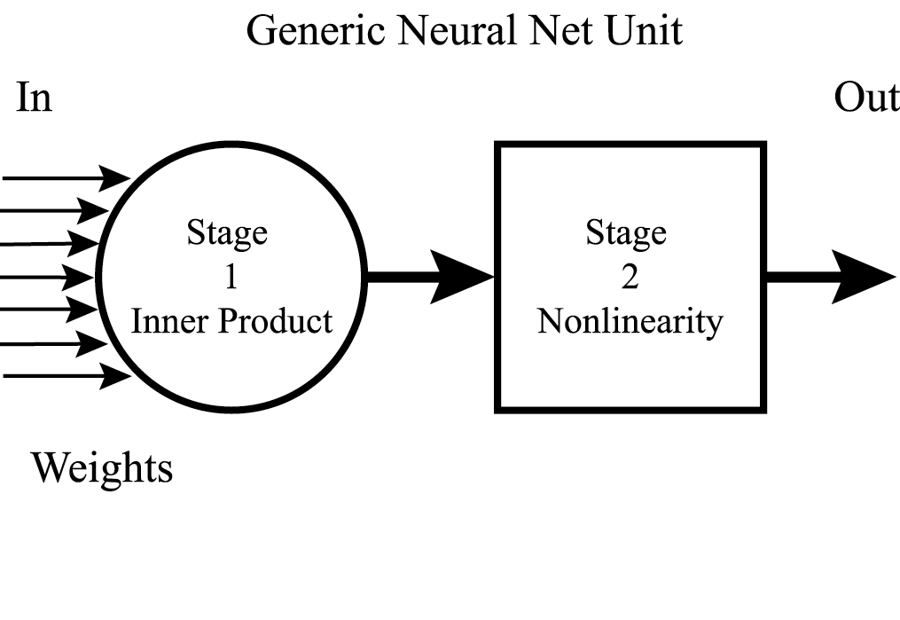
Neural Networks.
16.1 Introduction
16.2 What is cognitive computing?
16.3 Definition
16.4 How cognitive computing work?
16.5 Cognitive computing Vs Artificial intelligence
16.6 Foundation of cognitive computing
16.8 List of design principles of cognitive system
16.9 Natural language in support of cognitive system
The most successful brain inspired models are neural networks.
They are built from simple approximations of biological neurons: nonlinear integration of many weighted inputs.
Throw out all the other biological detail.
Cognitive computation is based on useful approximations.

Slide 12
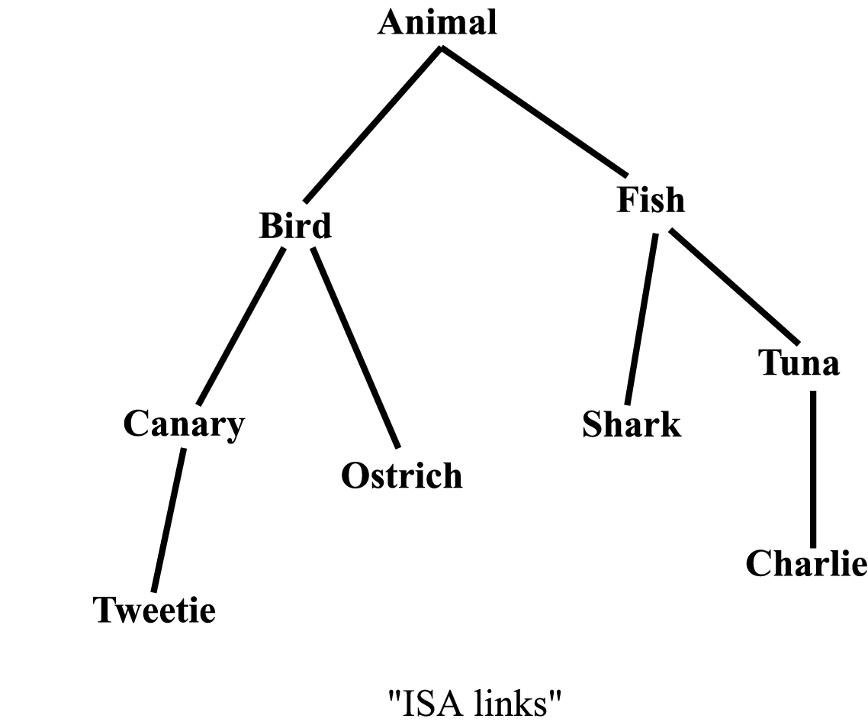
Second Extreme: Associatively Linked Networks.
16.1 Introduction
16.2 What is cognitive computing?
16.3 Definition
16.4 How cognitive computing work?
16.5 Cognitive computing Vs Artificial intelligence
16.6 Foundation of cognitive computing
16.8 List of design principles of cognitive system
16.9 Natural language in support of cognitive system
The second class of brain-like computing approximations is a basic part of computer science:
Associatively linked structures.
One example of such a structure is a semantic network.
Such structures underlie most of the practically successful applications of artificial intelligence.

Slide 13
Associatively Linked Networks (2)
16.1 Introduction
16.2 What is cognitive computing?
16.3 Definition
16.4 How cognitive computing work?
16.5 Cognitive computing Vs Artificial intelligence
16.6 Foundation of cognitive computing
16.8 List of design principles of cognitive system
16.9 Natural language in support of cognitive system
The connection between the biological nervous system and such a structure is unclear.
Few believe that nodes in a semantic network correspond to single neurons or groups of neurons.
Nodes are composed of many parts and contain significant internal structure.
Physiology (fMRI) shows that a complex cognitive structure – a word, for instance – gives rise to widely distributed cortical activation.
Virtue of Linked Networks: They have sparsely connected nodes.
In practical systems, the number of links converging on a node range from one or two up to a dozen or so.

Slide 14
Look at Some Examples
16.1 Introduction
16.2 What is cognitive computing?
16.3 Definition
16.4 How cognitive computing work?
16.5 Cognitive computing Vs Artificial intelligence
16.6 Foundation of cognitive computing
16.8 List of design principles of cognitive system
16.9 Natural language in support of cognitive system
The brain (and cognitive computation) do things differently:
If you build a brain expect to get weaknesses as well as strengths.
Both strengths and weaknesses are intrinsic to the hardware itself.
Give a few examples.

Slide 15
Cognitive Strengths
16.1 Introduction
16.2 What is cognitive computing?
16.3 Definition
16.4 How cognitive computing work?
16.5 Cognitive computing Vs Artificial intelligence
16.6 Foundation of cognitive computing
16.8 List of design principles of cognitive system
16.9 Natural language in support of cognitive system
Strengths:
Ability to approximate complex events in useful ways (using words, concepts).
Ability to integrate information from many sources.
Effective search of a large memory, that is, integration of past experience with the present situation.
Tight coupling of higher-level cognition with perception
Non-logical processes such as “intuition” for prediction and understanding.

Slide 16
Cognitive Weaknesses
16.1 Introduction
16.2 What is cognitive computing?
16.3 Definition
16.4 How cognitive computing work?
16.5 Cognitive computing Vs Artificial intelligence
16.6 Foundation of cognitive computing
16.8 List of design principles of cognitive system
16.9 Natural language in support of cognitive system
Weaknesses:
High error rate.
Slow responses compared to silicon time scales.
Alogical information processing, for example, association.
One result: Great difficulty with logic and formal reasoning.
Loss of detail in memory storage.
Interference from other memories.
Prejudice (jumping to conclusions).
Lack of explanation for actions.

Slide 17
Example: Concepts
16.1 Introduction
16.2 What is cognitive computing?
16.3 Definition
16.4 How cognitive computing work?
16.5 Cognitive computing Vs Artificial intelligence
16.6 Foundation of cognitive computing
16.8 List of design principles of cognitive system
16.9 Natural language in support of cognitive system
Concepts are labels for a large class of members that may differ substantially from each other. (For example, birds, tables, furniture.)
Reason: In the real world, events never recur exactly but constantly change:
Heraclitus: We never step twice into the same river. (500 B.C.E.)

Slide 18
Concepts as Distortions
16.1 Introduction
16.2 What is cognitive computing?
16.3 Definition
16.4 How cognitive computing work?
16.5 Cognitive computing Vs Artificial intelligence
16.6 Foundation of cognitive computing
16.8 List of design principles of cognitive system
16.9 Natural language in support of cognitive system
Humans use concepts in every aspect of cognition.
In language a word or a small group of words forms a concept descriptor.
Concepts have a rich internal structure: perceptual, associative, hierarchical.
Concepts are distortions and simplifications of reality but are essential for dealing with a variable world.
Perceptual systems are flooded with data.
Throw 99.9% of it out: A process of creative data destruction.
Sometimes can describe the remainder with concepts.
What is left is an adequate approximation of reality to be often “good enough” for dealing with the real world. (Dimensionality reduction, Lossy data compression.)

Slide 19
Example: Hierarchies in Concepts
16.1 Introduction
16.2 What is cognitive computing?
16.3 Definition
16.4 How cognitive computing work?
16.5 Cognitive computing Vs Artificial intelligence
16.6 Foundation of cognitive computing
16.8 List of design principles of cognitive system
16.9 Natural language in support of cognitive system
One of the most useful computational properties of human concepts is that they often show a hierarchical structure.
Examples might be:
animal > bird > canary > Tweetie
or
artifact > motor vehicle > car > Porsche > 911.

Slide 20
Example: Ambiguity
16.1 Introduction
16.2 What is cognitive computing?
16.3 Definition
16.4 How cognitive computing work?
16.5 Cognitive computing Vs Artificial intelligence
16.6 Foundation of cognitive computing
16.8 List of design principles of cognitive system
16.9 Natural language in support of cognitive system
However, language is highly ambiguous at all levels.
This is a terrible way to design a communication system.
Word Ambiguity:
911 can be a
Porsche model
Emergency number
Date of an important event

Slide 21
Ambiguity
16.1 Introduction
16.2 What is cognitive computing?
16.3 Definition
16.4 How cognitive computing work?
16.5 Cognitive computing Vs Artificial intelligence
16.6 Foundation of cognitive computing
16.8 List of design principles of cognitive system
16.9 Natural language in support of cognitive system
Ambiguity may be bad only if you are interested in machine translation! Or a lawyer! Or a philosopher!
Ambiguity was the downfall of early machine translation.
But: Real words almost always appear in a context.
Words and context work together to make a powerful, very fast, effectively directed, memory access, integration, and interpretation system.
Nothing artificial can come close to its performance!

Slide 22
911: Context 1
16.1 Introduction
16.2 What is cognitive computing?
16.3 Definition
16.4 How cognitive computing work?
16.5 Cognitive computing Vs Artificial intelligence
16.6 Foundation of cognitive computing
16.8 List of design principles of cognitive system
16.9 Natural language in support of cognitive system
Car context:
Vehicle Porsche German Zuffenhausen
911
Sports Car High Performance Rear engine

Slide 23
911: Context 2
16.1 Introduction
16.2 What is cognitive computing?
16.3 Definition
16.4 How cognitive computing work?
16.5 Cognitive computing Vs Artificial intelligence
16.6 Foundation of cognitive computing
16.8 List of design principles of cognitive system
16.9 Natural language in support of cognitive system
Emergency context:
Telephone Emergency Police Danger
911
Fire Ambulance Quick response TV News

Slide 24
911: Context 3
16.1 Introduction
16.2 What is cognitive computing?
16.3 Definition
16.4 How cognitive computing work?
16.5 Cognitive computing Vs Artificial intelligence
16.6 Foundation of cognitive computing
16.8 List of design principles of cognitive system
16.9 Natural language in support of cognitive system
Terrorist context:
September 11 Terrorism New York War
911
Disaster Attack Politics Middle-East News
This particular word context is new, showing the flexibility and rapid learning ability of the system.

Slide 25
Example: Arithmetic
16.1 Introduction
16.2 What is cognitive computing?
16.3 Definition
16.4 How cognitive computing work?
16.5 Cognitive computing Vs Artificial intelligence
16.6 Foundation of cognitive computing
16.8 List of design principles of cognitive system
16.9 Natural language in support of cognitive system
Arithmetic is an important cognitive function, but:
Done very differently by computers and humans!
Digital computers compute the answers to arithmetic.
Humans estimate, perceive, and memorize the answers.

Slide 26
Example: The Human Algorithm for Multiplication
16.1 Introduction
16.2 What is cognitive computing?
16.3 Definition
16.4 How cognitive computing work?
16.5 Cognitive computing Vs Artificial intelligence
16.6 Foundation of cognitive computing
16.8 List of design principles of cognitive system
16.9 Natural language in support of cognitive system
Conclusions from a long research project:
The correct answer to a multiplication problem is:
1. Familiar (that is, a product number, an answer to some multiplication problem)
2. About the right size.

Slide 27
Example: The Human Algorithm for Multiplication
16.1 Introduction
16.2 What is cognitive computing?
16.3 Definition
16.4 How cognitive computing work?
16.5 Cognitive computing Vs Artificial intelligence
16.6 Foundation of cognitive computing
16.8 List of design principles of cognitive system
16.9 Natural language in support of cognitive system
Arithmetic fact learning is a memory and estimation process.
It is not a true computation!
Makes Predictions:
Rarely see 51 or 53 as errors.
Never see 3 or 6 as answers to 6x9.

Slide 28
Example: Relationships
16.1 Introduction
16.2 What is cognitive computing?
16.3 Definition
16.4 How cognitive computing work?
16.5 Cognitive computing Vs Artificial intelligence
16.6 Foundation of cognitive computing
16.8 List of design principles of cognitive system
16.9 Natural language in support of cognitive system
In human perception and cognition computation, relationships are often more valuable than exact values.
Relationships can be more stable than exact values of sensory quantities.
Common perceptual invariances:
Size (distance).
Color (with respect to illumination).
Objects (with respect to orientation, some distortions)
Vocal tract length (speaker independent speech).

Slide 29

Example: Relationships Consider:
16.1 Introduction
16.2 What is cognitive computing?
16.3 Definition
16.4 How cognitive computing work?
16.5 Cognitive computing Vs Artificial intelligence
16.6 Foundation of cognitive computing
16.8 List of design principles of cognitive system
16.9 Natural language in support of cognitive system

Slide 30
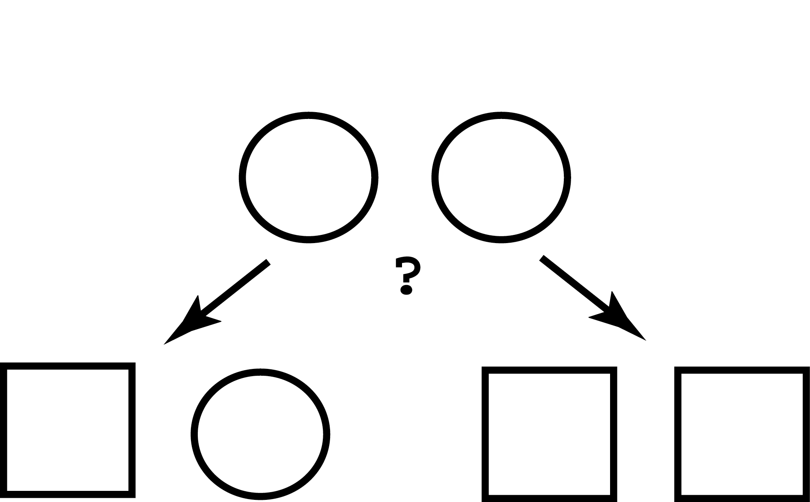
Which pair is most similar?
16.1 Introduction
16.2 What is cognitive computing?
16.3 Definition
16.4 How cognitive computing work?
16.5 Cognitive computing Vs Artificial intelligence
16.6 Foundation of cognitive computing
16.8 List of design principles of cognitive system
16.9 Natural language in support of cognitive system

Slide 31
Experimental Results
16.1 Introduction
16.2 What is cognitive computing?
16.3 Definition
16.4 How cognitive computing work?
16.5 Cognitive computing Vs Artificial intelligence
16.6 Foundation of cognitive computing
16.8 List of design principles of cognitive system
16.9 Natural language in support of cognitive system
One pair has high physical similarity to the initial stimulus, that is, one half of the figure is identical.
The other pair has high relational similarity, that is, they form a pair of identical figures.
Adults tend to choose relational similarity.
Children tend to choose physical similarity.
However, It is easy to bias adults and children toward either relational or physical similarity. Potentially a very flexible and programmable system.

Slide 32
Introduction
16.1 Introduction
16.2 What is cognitive computing?
16.3 Definition
16.4 How cognitive computing work?
16.5 Cognitive computing Vs Artificial intelligence
16.6 Foundation of cognitive computing
16.8 List of design principles of cognitive system
16.9 Natural language in support of cognitive system
Cognitive computing (CC) and cognitive technologies prove to be the game changers for the forthcoming engineering systems and for the engineering practice and training. These are leading drivers for the knowledge automation work, and the establishment of cognitive products with the higher level of intelligence as compared to that of the present smart product.
The cognitive assistants involve, individually or collectively, with humans through a combination of adaptive multimodal interfaces and progressive techniques of visualization and navigation.
CC defines technology platforms that aids the scientific disciplines of artificial intelligence (AI) and signal process. These platforms envelops machine learning, reasoning, tongue process, speech recognition and vision (object recognition), human–computer interaction, dialog and narrative generation, among the alternative technologies.

Slide 33
What is cognitive computing?
16.1 Introduction
16.2 What is cognitive computing?
16.3 Definition
16.4 How cognitive computing work?
16.5 Cognitive computing Vs Artificial intelligence
16.6 Foundation of cognitive computing
16.8 List of design principles of cognitive system
16.9 Natural language in support of cognitive system
CC systems avail processed models to simulate the human knowledge method to inspect solutions in an advanced things wherever the answers seem to be ambiguous and uncertain. While the term psychological feature computing is used interchangeably with computing (AI), CC overlaps with AI and engages several constant underlying technologies to power psychological feature applications, along with professional systems, neural networks, AI and video game (VR).
Definition
A computer with a brain that thinks and performs like a human being. Nothing is unattainable in this tech- nological revolution that proceeds to surprise us day after day! Nowadays, one can provide “eyes and a brain” to one’s computer: thus, one may be able to replace humans for the repetitive tasks and immensely facilitate our daily life. In present day, this approach is known as Cognitive Computing.

Slide 34
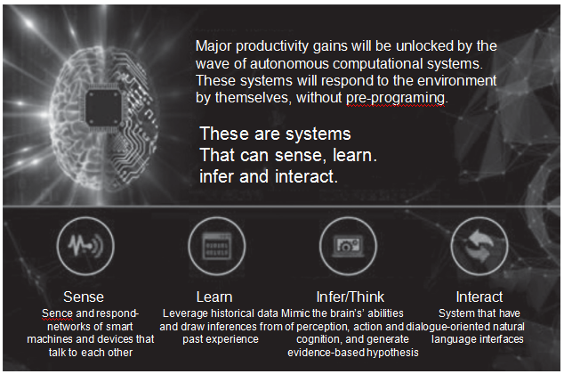
16.1 Introduction
16.2 What is cognitive computing?
16.3 Definition
16.4 How cognitive computing work?
16.5 Cognitive computing Vs Artificial intelligence
16.6 Foundation of cognitive computing
16.8 List of design principles of cognitive system
16.9 Natural language in support of cognitive system

Slide 35
How cognitive computing works?
16.1 Introduction
16.2 What is cognitive computing?
16.3 Definition
16.4 How cognitive computing work?
16.5 Cognitive computing Vs Artificial intelligence
16.6 Foundation of cognitive computing
16.8 List of design principles of cognitive system
16.9 Natural language in support of cognitive system
CC is a fusion of some of the most exciting technologies around, and it aims to make the best use of them.
To gain capabilities, psychological feature computing systems should have five key attributes, as recorded by the psychological feature computing association. These are as follows:
Adaptive: The adaptive computing systems may learn as information changes and goals and requirements evolve. These may resolve ambiguity and tolerate unpredictability, and may be further engineered to feed on dynamic data in real time, or near real time.
Interactive: The interactive computing systems will simply move with users so those users will outline their desires well. These may move additionally with various processors, devices and cloud services, in addition to folks.

Slide 36
How cognitive computing works?
16.1 Introduction
16.2 What is cognitive computing?
16.3 Definition
16.4 How cognitive computing work?
16.5 Cognitive computing Vs Artificial intelligence
16.6 Foundation of cognitive computing
16.8 List of design principles of cognitive system
16.9 Natural language in support of cognitive system
3. Iterative and stateful: These will aid in the process, a haul by asking queries or further finding supply input if a haul statement is ambiguous or incomplete. These may “remember” previous interactions in an exceedingly method and come info that’s appropriate for the particular application at that time in time.
4. Contextual: These will perceive, identify and extract discourse components which means syntax, time, location, applicable domain, rules, user’s profile, process, task and goal. These may draw on multiple sources of data, as well as each structured and unstructured digital info, in addition to sensory inputs (visual, gestural, auditory, or sensor provided).

Slide 37
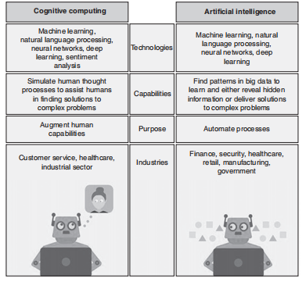
Cognitive computing Vs Artificial intelligence
16.1 Introduction
16.2 What is cognitive computing?
16.3 Definition
16.4 How cognitive computing work?
16.5 Cognitive computing Vs Artificial intelligence
16.6 Foundation of cognitive computing
16.8 List of design principles of cognitive system
16.9 Natural language in support of cognitive system

Slide 38
Foundation of cognitive computing
16.1 Introduction
16.2 What is cognitive computing?
16.3 Definition
16.4 How cognitive computing work?
16.5 Cognitive computing Vs Artificial intelligence
16.6 Foundation of cognitive computing
16.8 List of design principles of cognitive system
16.9 Natural language in support of cognitive system
Tabular era : The ﬁrst was the tabulating period (1890s–1940s), the early 1900 calculators and tabulating machines were made of mechanical systems and later of vacuum tubes.
Programmable era: The second era was the programmable era of computing (1950s–present), which ranged from vacuum tubes to microprocessors. Computing was effectively controlled by the programming furnished to the system.
Cognitive computing era: The third era includes cognitive computing era (2011–future), where CC technology represented an intersection between neuroscience, supercomputing and nanotechnology.

Slide 39
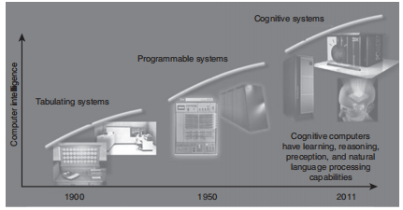
Foundation of cognitive computing
16.1 Introduction
16.2 What is cognitive computing?
16.3 Definition
16.4 How cognitive computing work?
16.5 Cognitive computing Vs Artificial intelligence
16.6 Foundation of cognitive computing
16.8 List of design principles of cognitive system
16.9 Natural language in support of cognitive system

Slide 40
List of design principles of cognitive system
16.1 Introduction
16.2 What is cognitive computing?
16.3 Definition
16.4 How cognitive computing work?
16.5 Cognitive computing Vs Artificial intelligence
16.6 Foundation of cognitive computing
16.8 List of design principles of cognitive system
16.9 Natural language in support of cognitive system
General cognitive design principle: According to Principle of Congruence, the structure and content of an image ought to correspond to the structure and content of the desired mental representation. On contrary to this, Principle of Apprehension states that the structure and content of a visualization should be readily and accurately perceived and comprehended.
If individuals imagine animated events as sequences of discrete steps, it may be more effective to visualize events in steps rather than requiring the user to do the segmentation. For example, a sequence of stills may actually provide a more compatible cognitive match than an animation. A sequence of stills allows viewers to compare directly the state of the system at every necessary step.

Slide 41
List of design principles of cognitive system
16.1 Introduction
16.2 What is cognitive computing?
16.3 Definition
16.4 How cognitive computing work?
16.5 Cognitive computing Vs Artificial intelligence
16.6 Foundation of cognitive computing
16.8 List of design principles of cognitive system
16.9 Natural language in support of cognitive system
2. Individualizing visualizations: The utility of many visualizations depends on their ability. Our vision is to mechanically make personalized visualizations using computer algorithms that instantiate principles of cognitive design. To do this, we need methods for uncovering principles cognitive design and methods for incorporating these principles into computer algorithms.
Assembly directions are representative of an outsized category of visualizations that features instructions on how to place something together and how to operate a complex system—as well as how complex systems, from hearts to corporate structures, function. For example, frescoes in Egyptian tombs show how crops are grown and harvested. Within each domain, we have selected to explore and develop examples which are likely to be familiar to the general public—for maps, route maps and systems, assembly instructions.

Slide 42
List of design principles of cognitive system
16.1 Introduction
16.2 What is cognitive computing?
16.3 Definition
16.4 How cognitive computing work?
16.5 Cognitive computing Vs Artificial intelligence
16.6 Foundation of cognitive computing
16.8 List of design principles of cognitive system
16.9 Natural language in support of cognitive system
3. Revealing cognitive design principle: Visualizations that are congruent with the specified mental representations need techniques that reveal those internal mental representations. Cognitive psychology incorporates a giant bag of tricks for externalizing the internal. Reaction times are commonly used to this end. The reasoning typically goes as follows: if the mental representation has a certain format, the responses for the retrieval tasks congruent with that format should be quicker and additional correct than responses for formats that does not seem to be congruent with the format, as these require more onerous and time-consuming mental transformations
For complex mental representations, more open-ended techniques maybe more revealing. One that we have adopted is to ask participants to construct descriptions and depictions for a given domain. This captures the natural way that communication occurs, and provides us with a rich set of data.

Slide 43
Natural language in support of cognitive system
16.1 Introduction
16.2 What is cognitive computing?
16.3 Definition
16.4 How cognitive computing work?
16.5 Cognitive computing Vs Artificial intelligence
16.6 Foundation of cognitive computing
16.8 List of design principles of cognitive system
16.9 Natural language in support of cognitive system
Natural language is a product of human mind. It is the part of our overall cognitive make-up and relates to perception, reasoning, imagination and, most importantly, to the experience of our body and the world around us.
The main aim of cognitive linguistics is to define how the mind works. In fact, it would be completely odd to consider language as a self-contained module, since it was isolated from the people who utilize it in communicating meanings.
The psychological experiments have demon- strated that human reasoning is completely diverse from the logical reasoning.

Slide 44
Natural language in support of cognitive system
16.1 Introduction
16.2 What is cognitive computing?
16.3 Definition
16.4 How cognitive computing work?
16.5 Cognitive computing Vs Artificial intelligence
16.6 Foundation of cognitive computing
16.8 List of design principles of cognitive system
16.9 Natural language in support of cognitive system
For example:
GIVEN: If Roger is a musician then Roger is a Bavarian
SUPPOSE: Roger is not a Bavarian
THEN:
It must be the case that Roger is a musician
May be Roger is a musician, may be he is not
It must be the case that Roger is not a musician
Logically, the problem related to the conditional reasoning along with the negation of a subsequent is known as modus tollens. This can be given by the formula: if p then q; not q; therefore not p.
Most of us, justify on the basis of meaningfulness and not on the rules of logic. The peculiar information for musicians and Bavarians drive no sense in the world as are aware of it, and the abstract formula is completely ahead of our imagination.

Slide 45
Conclusions
16.1 Introduction
16.2 What is cognitive computing?
16.3 Definition
16.4 How cognitive computing work?
16.5 Cognitive computing Vs Artificial intelligence
16.6 Foundation of cognitive computing
16.8 List of design principles of cognitive system
16.9 Natural language in support of cognitive system
Brains are very different in their basic style of computation than computers.
They work largely with memory, sensory, and perceptually based information.
They are not logical.
They integrate information from many sources.
They approximate a complex world using entities like words and concepts.
They work effectively with relationships.
They use context effectively.
They can work quickly and effectively with very large memories.

Slide 46
Conclusions
16.1 Introduction
16.2 What is cognitive computing?
16.3 Definition
16.4 How cognitive computing work?
16.5 Cognitive computing Vs Artificial intelligence
16.6 Foundation of cognitive computing
16.8 List of design principles of cognitive system
16.9 Natural language in support of cognitive system
Many of the these style differences arise from the necessities arising from grossly different hardware.
They compute the different ways they do because they have to!
Brains and computers are complementary in their strengths and weaknesses.
But: we already have computer-like computers.
If we want to do real cognitive computation we need to build brain-like computers!

Slide 47
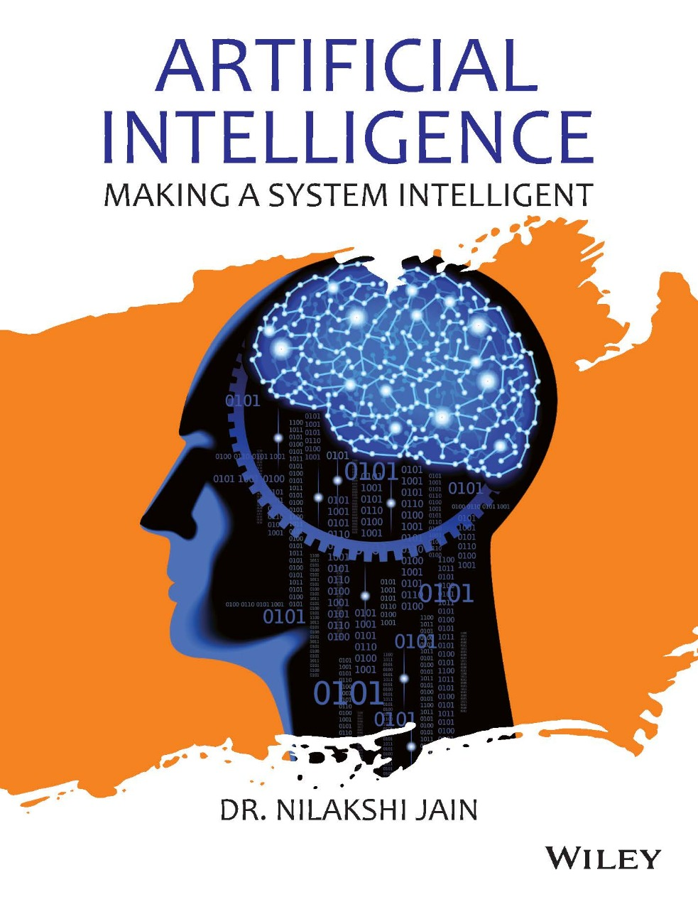
Dr. Nilakshi Jain Email ID : nilakshijain1986@gmail.com
Thank you

